Slide 1
Lesson objective
Need whiteboards and calculators.
Title: Comparing the price
Aim – be able to:
Use unitary methods to compare best buys
Plan:
Review unitary method
Fluency

Slide 2
Whiteboards
Divide to get 100g cost
Times by 10 to get $ per kilo
Sally paid $11.50 for 400g of ham. How much was it for
100g
1kg

Slide 3
Whiteboards
Divide to get 100g cost
Times by 10 to get $ per kilo
A jar of Nutella costs $6.90 for 300g. How much is it per:
100g
1kg

Slide 4
Whiteboards
Divide to get 100g cost
Times by 10 to get $ per kilo
Beans cost $9.25 for 500g. How much are they for:
100g
1kg

Slide 5
Whiteboards
Divide to get 100g cost
Times by 10 to get $ per kilo
Which is better value? Compare 100g prices
Mr. Davies favourite chocolate
Some other chocolate
$8 for 200g.
$18 for 500g

Slide 6
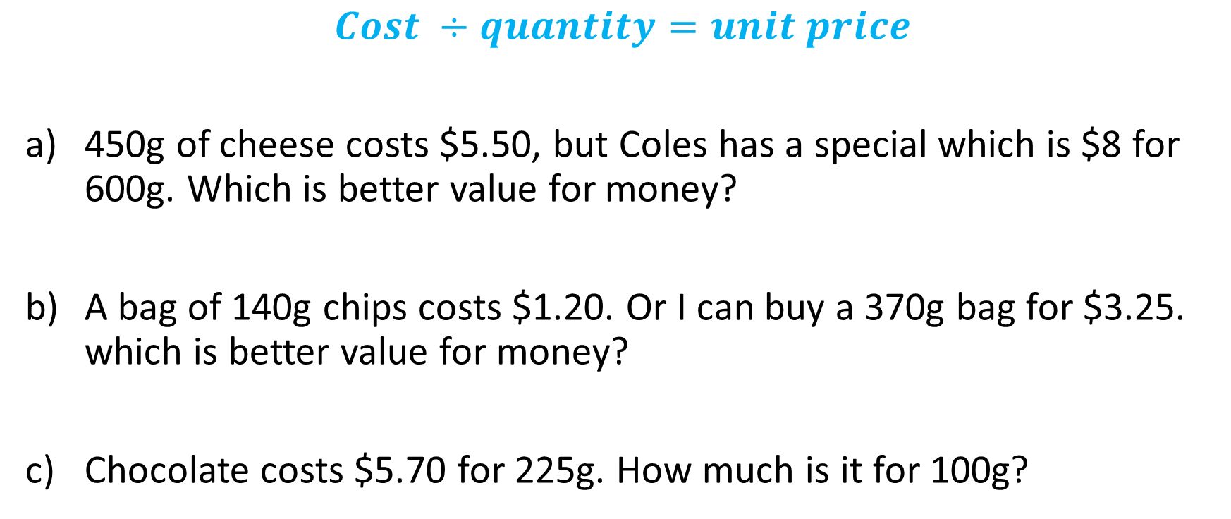
Comparing price: unitary method
$$Cost ÷quantity=unit price$$
450g of cheese costs $5.50, but Coles has a special which is $8 for 600g. Which is better value for money?
A bag of 140g chips costs $1.20. Or I can buy a 370g bag for $3.25. which is better value for money?
Chocolate costs $5.70 for 225g. How much is it for 100g?

Slide 7
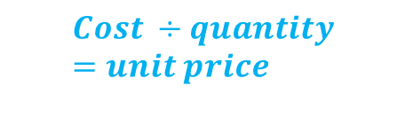
We do
$$Cost ÷quantity=unit price$$
410g of bait costs $11.40. 1kg of bait costs $25.50. which is better value?
The movies sell Maltesers at $9.20 for 425g. Woolies sells a 600g bag for $12.50 – which is better value for money?
Vegemite costs $6.70 for 325g. How much is it for 100g?

Slide 8
Comparing best buys task sheet

